Slide 1

Archbishop M.C. O’Neill Catholic High School
Gr. 10-12 Subject Selection

Slide 2
Subject selection will run from February 26th-March 5th
Gr. 10 Students must select 10 classes (Choral, Band, Vocal Jazz, Instrumental Jazz may be taken in addition to the 10 required classes.).
We recommend that all students select ten classes.
Students will log on to MySchoolSask (MSS) to enter classes for next year

Slide 3
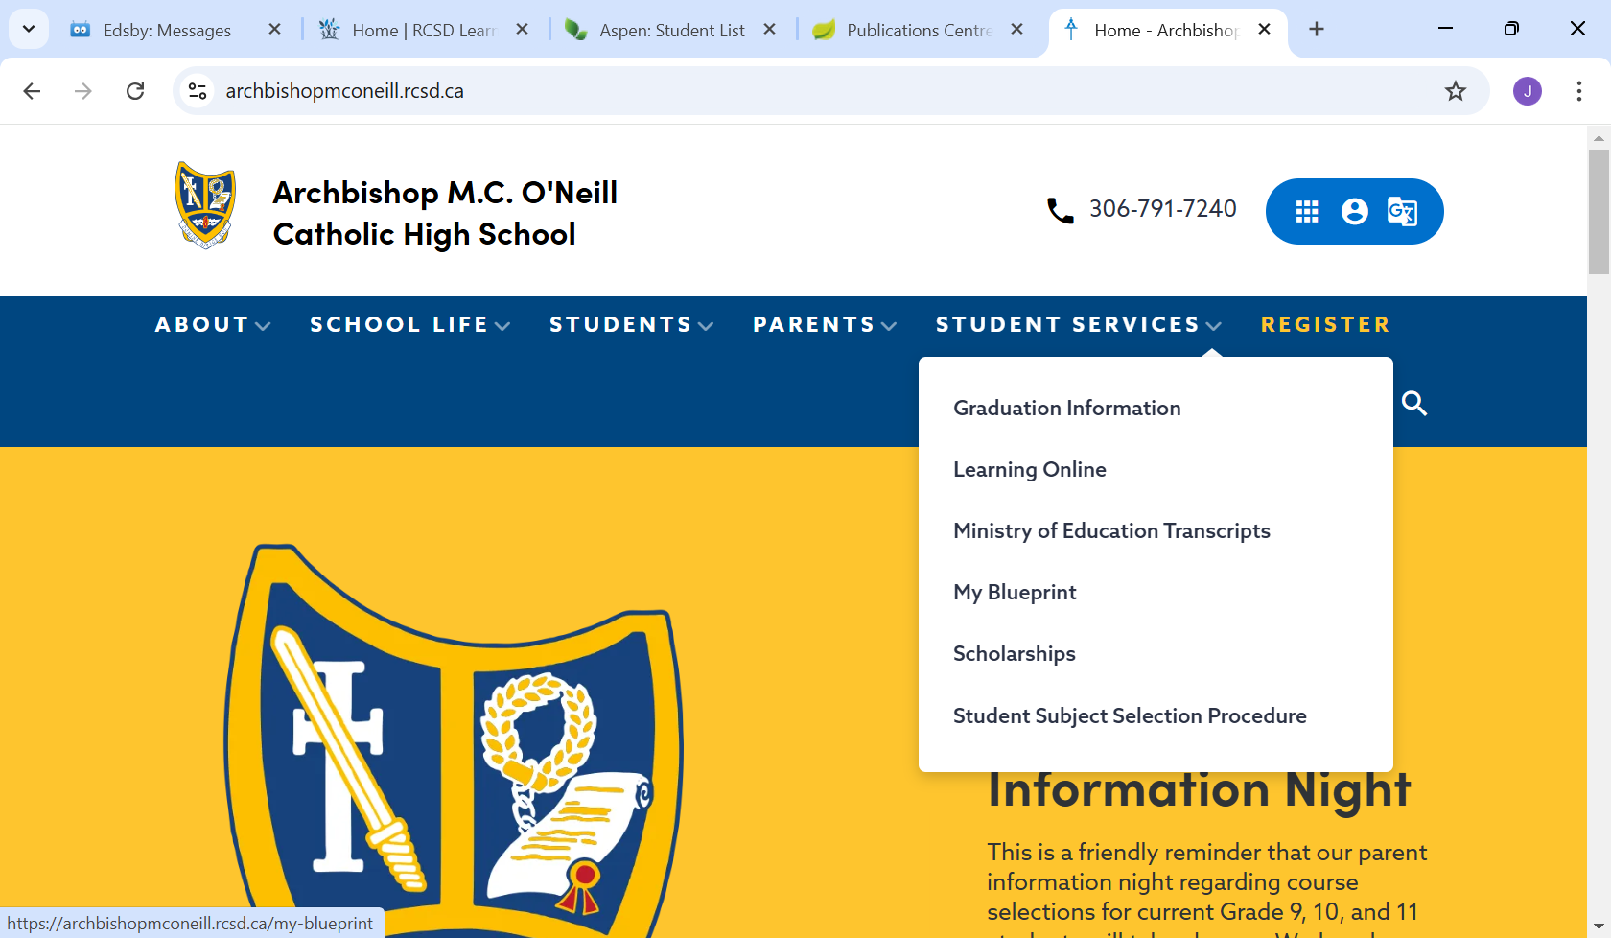
https://archbishopmconeill.rcsd.ca/student-subject-selection-procedure

Slide 4
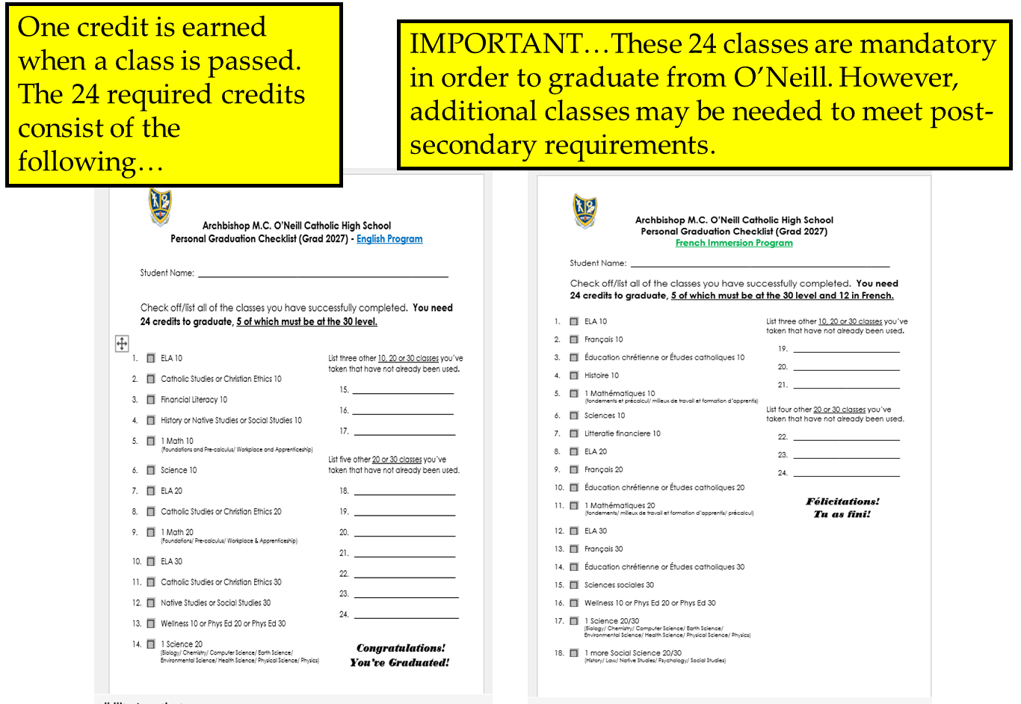
Minimum of 24 Credits to Graduate

Slide 5
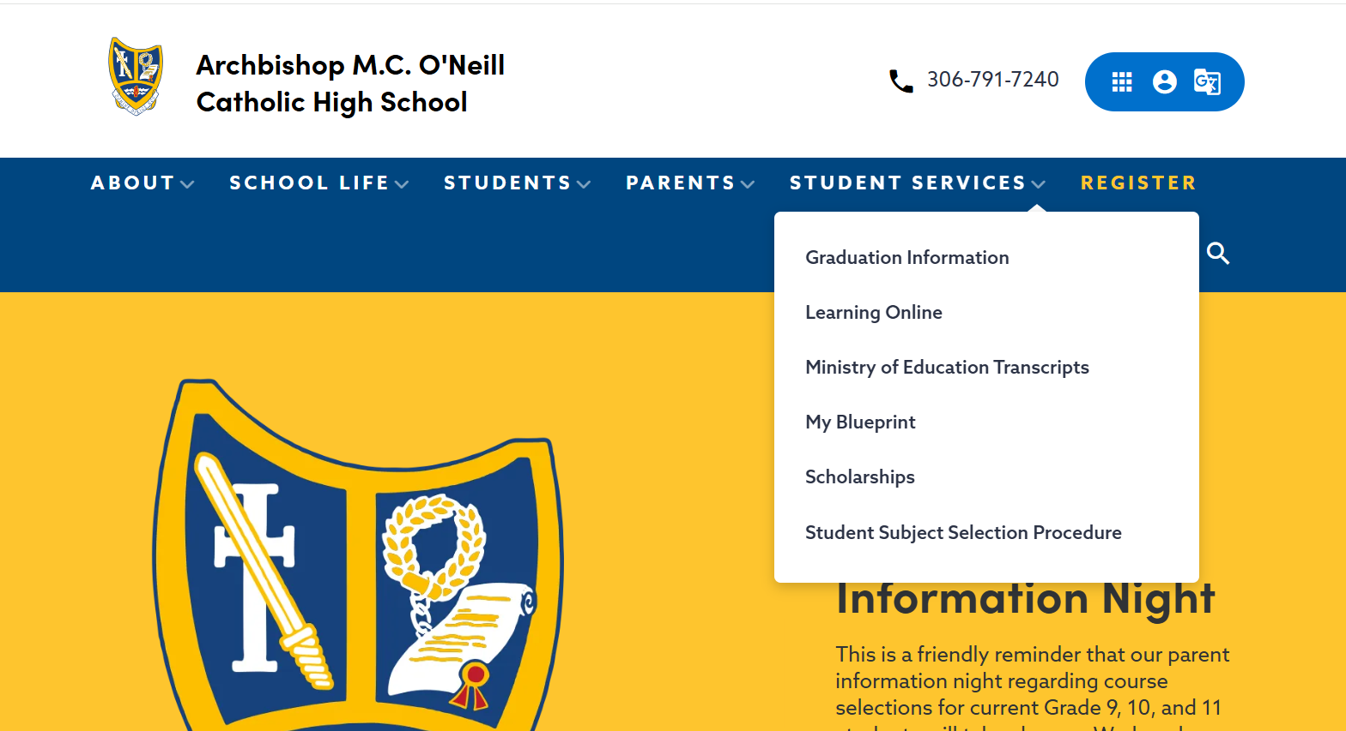
My BluePrint

Slide 6
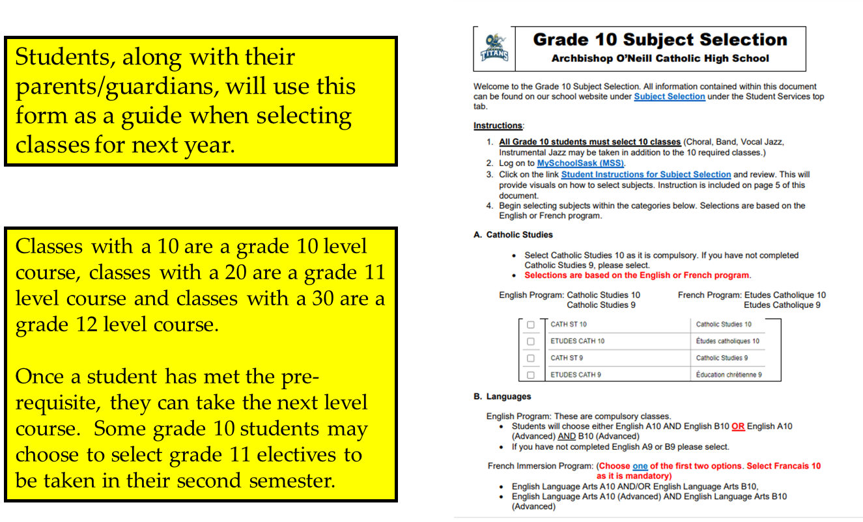
Subject Selection Form

Slide 7
Step 1 (Gr. 10 English Program)
Select 6 Core Classes
There are 6 mandatory classes for Grade 10
students in the English Program.
ELA 10 or ELA 10AD
Financial Literacy 10
Math F/P 10 and/or Math W/A 10
Science 10
History 10 or Native Studies 10
Catholic Studies 10
Grade 10 students MUST select 10 classes
(6 core classes and 4 electives)
NOT including Band, Instrumental Jazz, Choral and Vocal Jazz

Slide 8
Step 1 (Gr. 10 French Immersion)
Select 7 Core Classes
There are 7 mandatory classes for Grade 10
students in the French Immersion Program.
1) ELA 10 or ELA 10AD
2) Français 10
3) Maths fondements et précalcul 10
4) Sciences 10
5) Histoire 10
6) Études catholique 10
7) Litteratie financiere 10
Grade 10 FI students MUST select 10 classes
(7 core classes and 3 electives)
NOT including Band, Instrumental Jazz, Choral and Vocal Jazz

Slide 9
The following slides outline the…
Math pathways (including a recommendation chart prepared by the math teachers) and Science pathways.

Slide 10
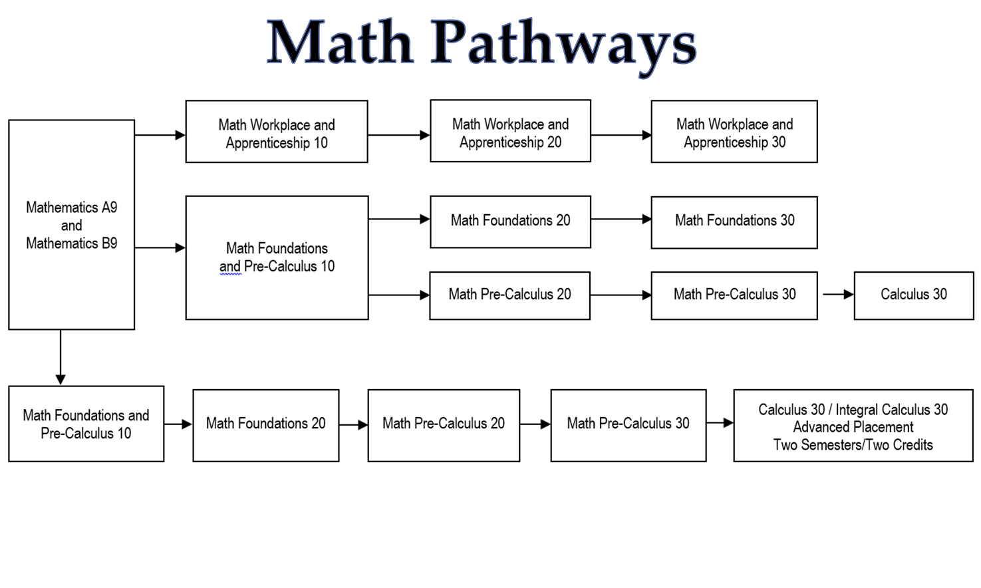

Slide 11
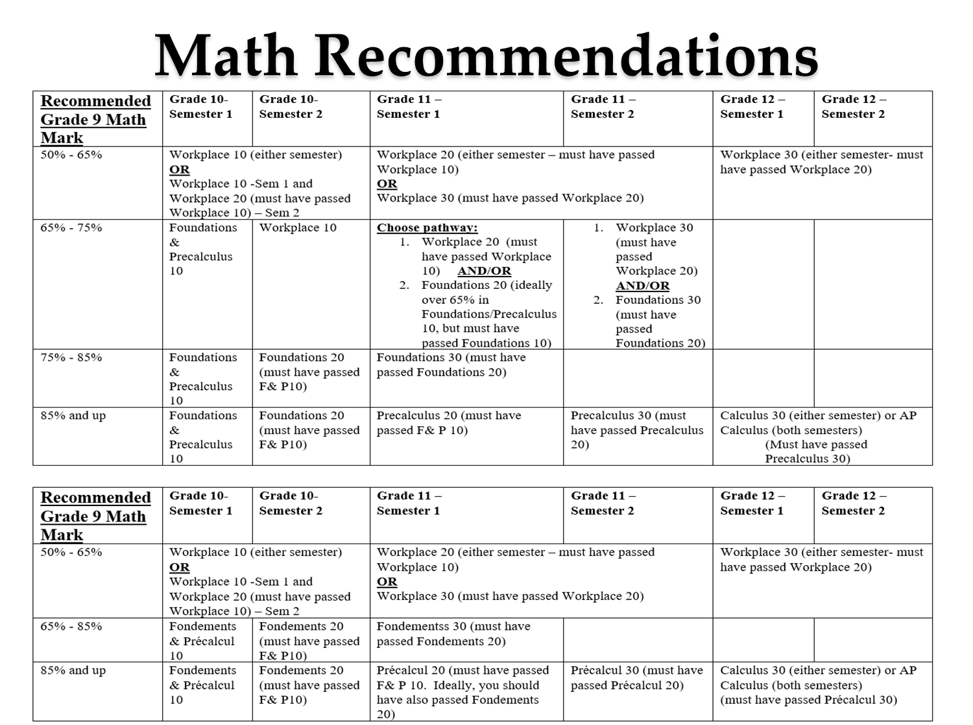

Slide 12
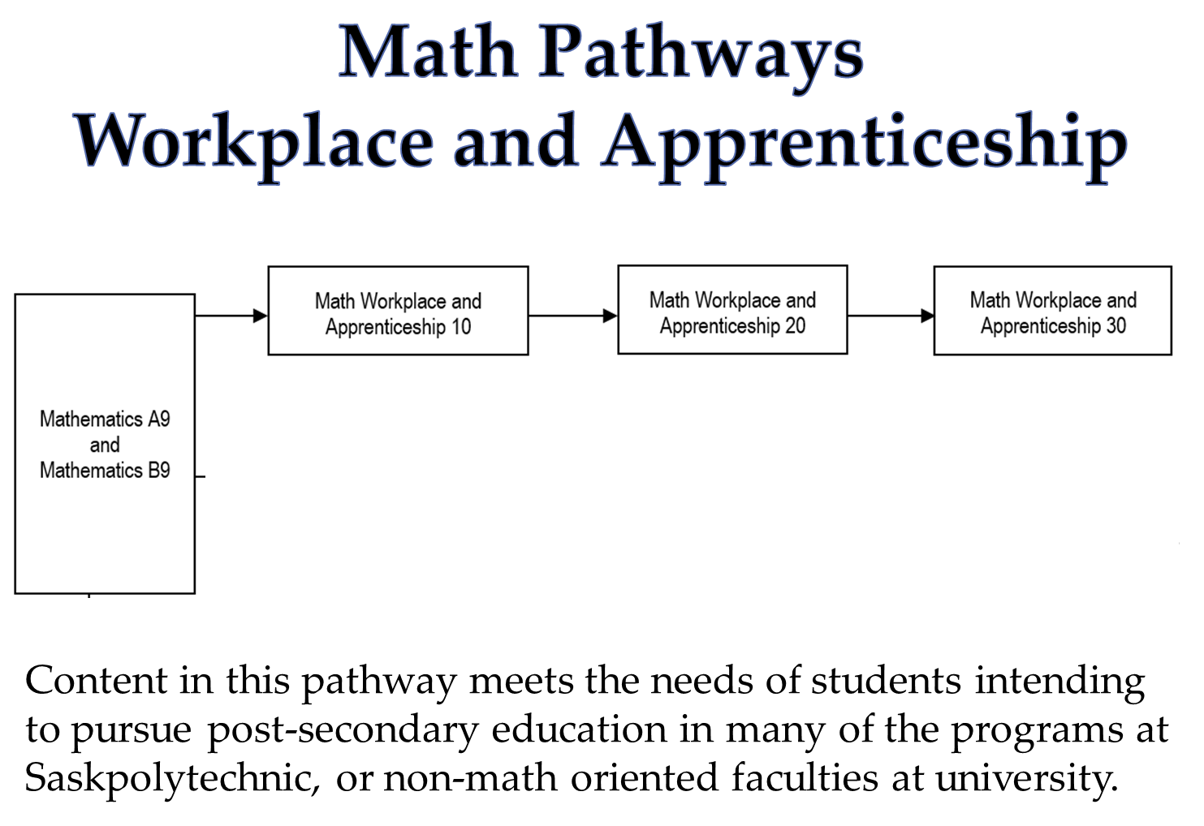

Slide 13
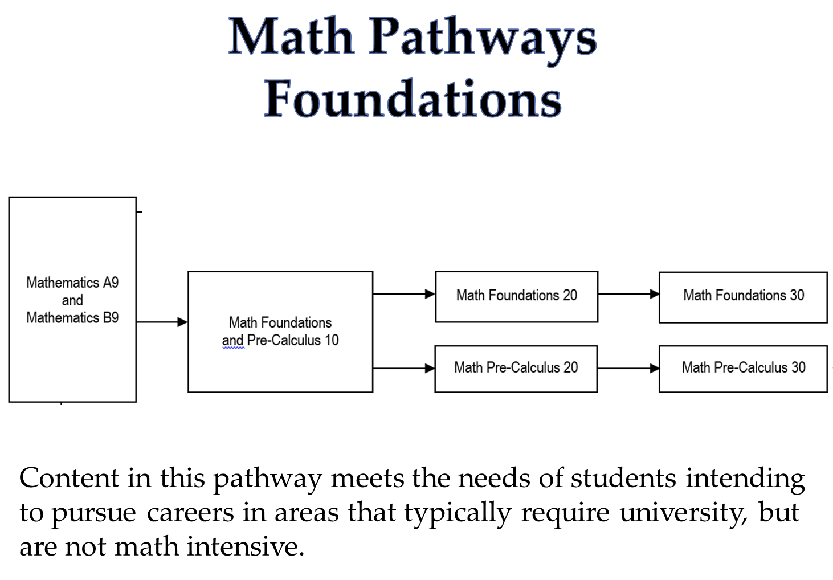

Slide 14
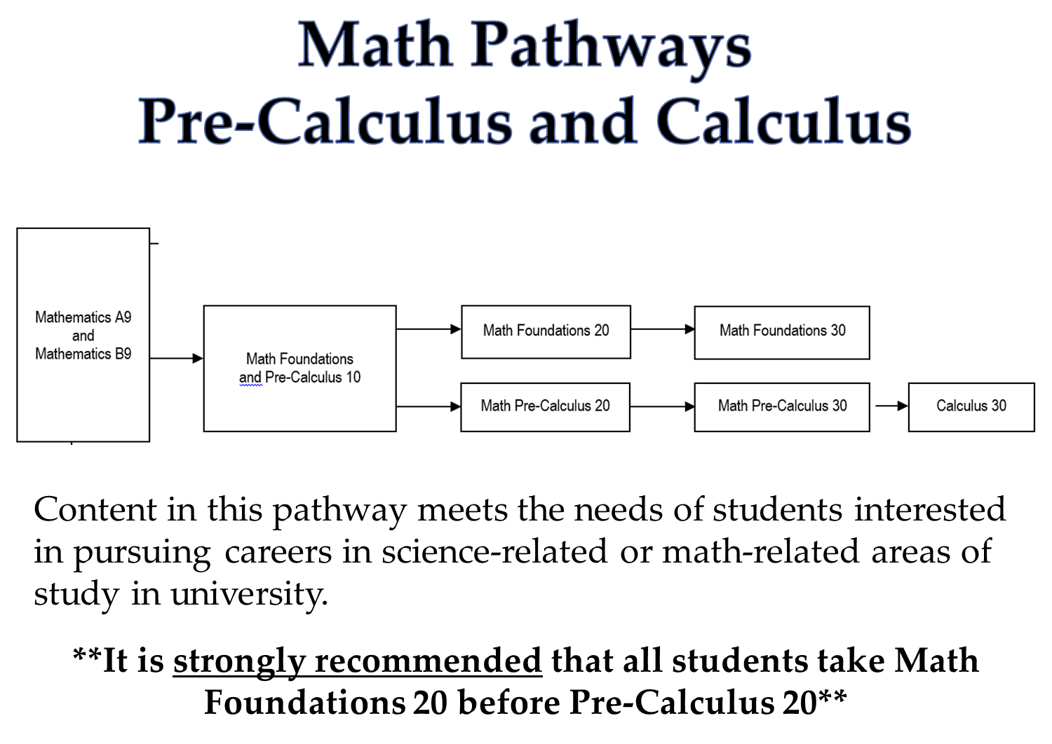

Slide 15
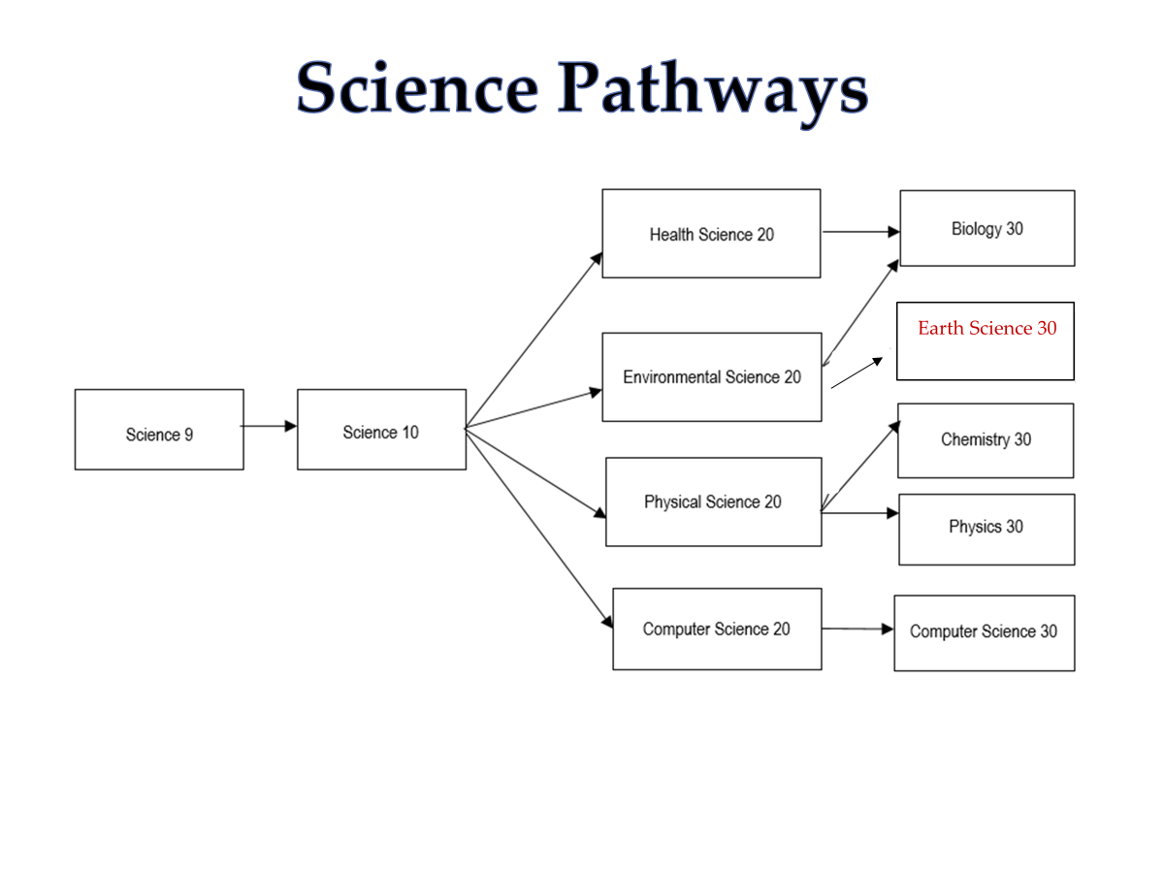

Slide 16
Science
If you are going to take a 20 level science in Gr. 10, we recommend taking Health Science 20 or Environmental Science 20

Slide 17
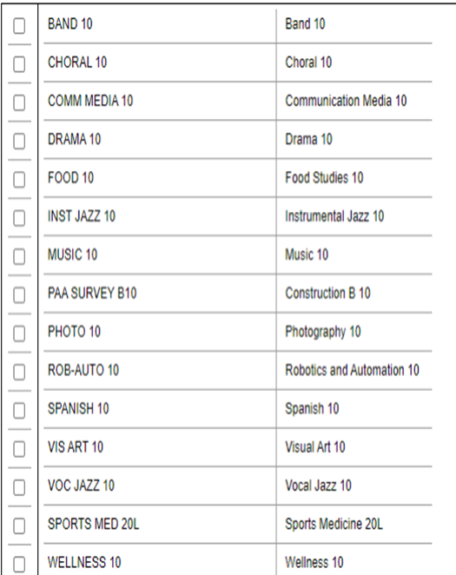
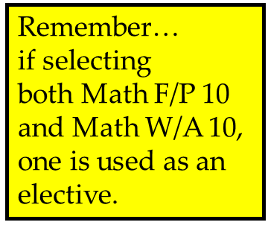
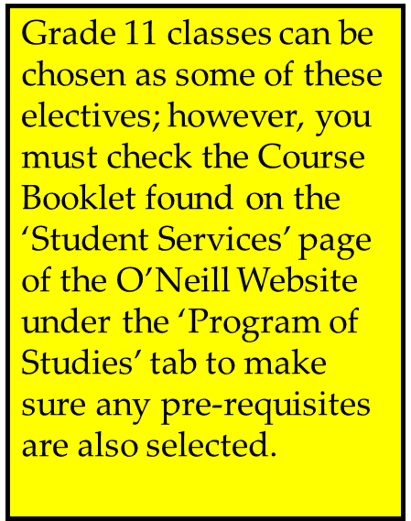
Gr. 10 Step 2 Select Elective Subjects

Slide 18
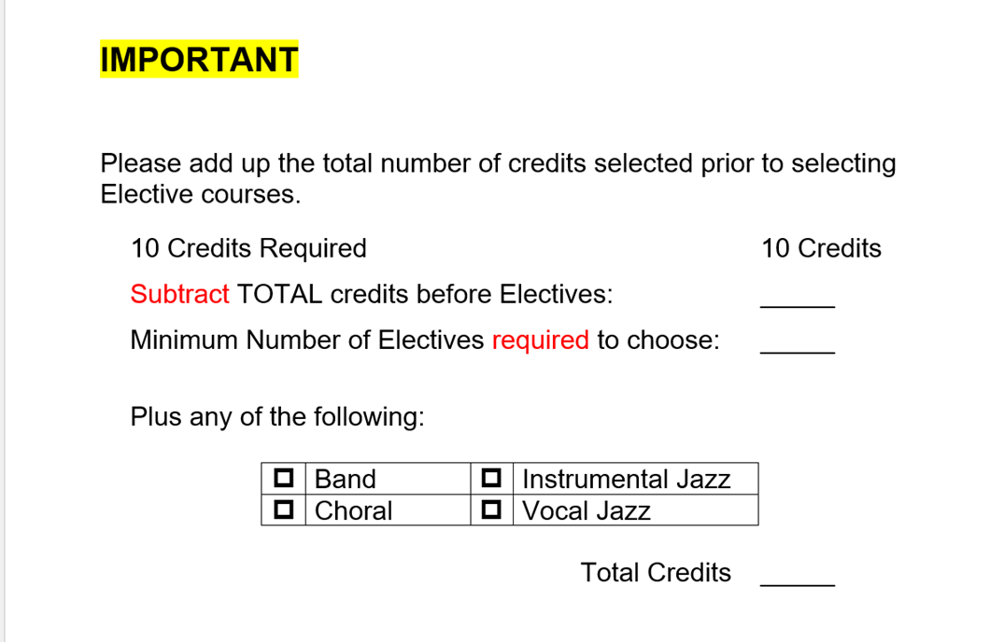
**Make sure you have selected 10 classes (not including choral, band or vocal jazz)**

Slide 19

Step 1 (Gr. 11 English Program)
Select 5 Core Classes
There are 4 mandatory classes for Grade 11
students in the English Program.
ELA 20 or ELA 20 AD
20 level Math
20 level Science
Catholic Studies 20

Slide 20

Step 1 ( Gr. 11 French Immersion)
Select 6 Core Classes
There are 5 mandatory classes for Grade 11
students in the French Immersion Program.
ELA 20 or ELA 20 AD
Français 20
Maths 20 (Fondements 20, Précalcul 20)
20 Level Science
Études catholique 20

Slide 21
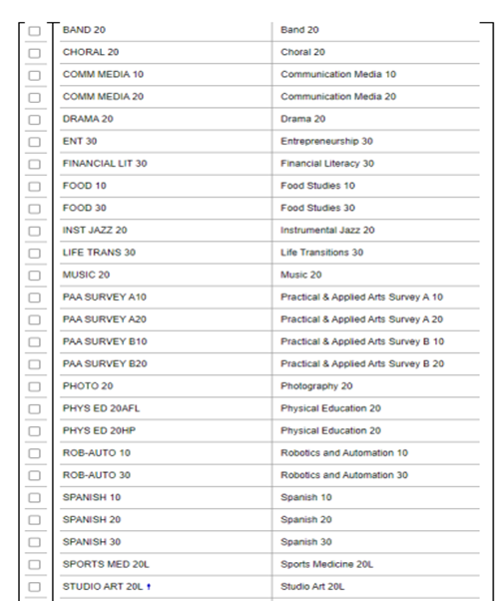
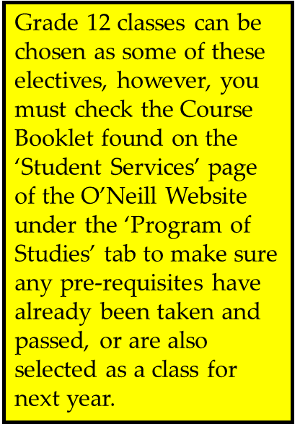
Step 2 Gr. 11
Select Elective Subjects

Slide 22

Step 1 (Gr. 12 English Program)
Select 4 Core Classes
There are 4 mandatory classes for Grade 12
students in the English Program
ELA A30 (or ELA A30 AP)
ELA B30 (or ELA B30 AP)
Social Studies or Native Studies 30
Catholic Studies 30
Social Studies 30 or Native Studies 30 MUST be taken in addition to the 20 or 30 level Social Science course listed for grade 11.

Slide 23

Step 1 (Gr. 12 French Immersion)
Select 4 Core Classes
French Immersion students must have 12 French credits by the end of Grade 12.
There are 4 mandatory classes for Grade 12
students in the French Immersion Program.
ELA A30 and/or
ELA B30 (if taking AP, both must be taken)
2) Français 30
3) Sciences sociales 30
4) Études catholique 30

Slide 24
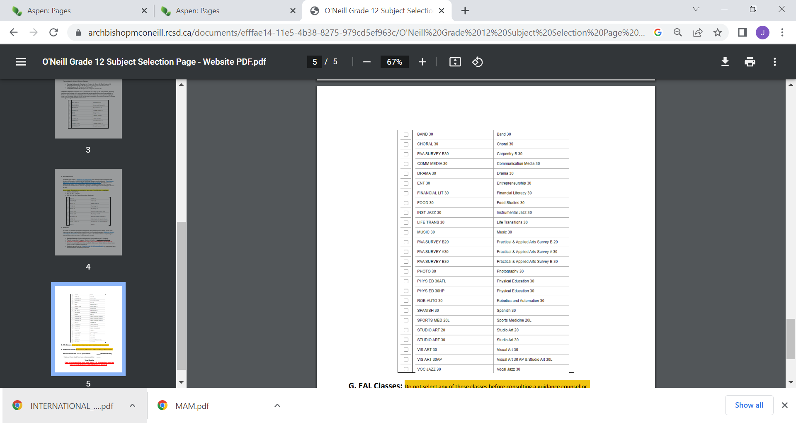
Step 2 Gr. 12
Select Elective Subjects
IMPORTANT…
By the end of grade 12, students must have five 30 level classes in total in order to graduate.

Slide 25
**Make sure you have selected 10 classes (not including choral, band or vocal jazz)**

Slide 26
Advanced Placement Programs
Students can challenge themselves academically.
Provides opportunities for higher level thinking and more in-depth application of knowledge and skills.
Scoring a 4 or 5 on an AP exam will help students gain university credit (save time and money)

Slide 27
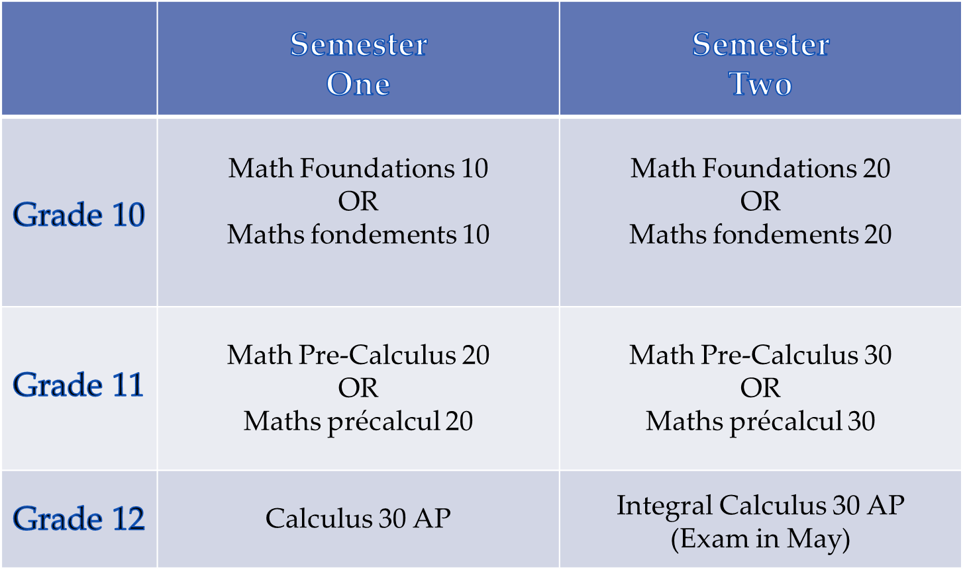
AP Math Pathway

Slide 28
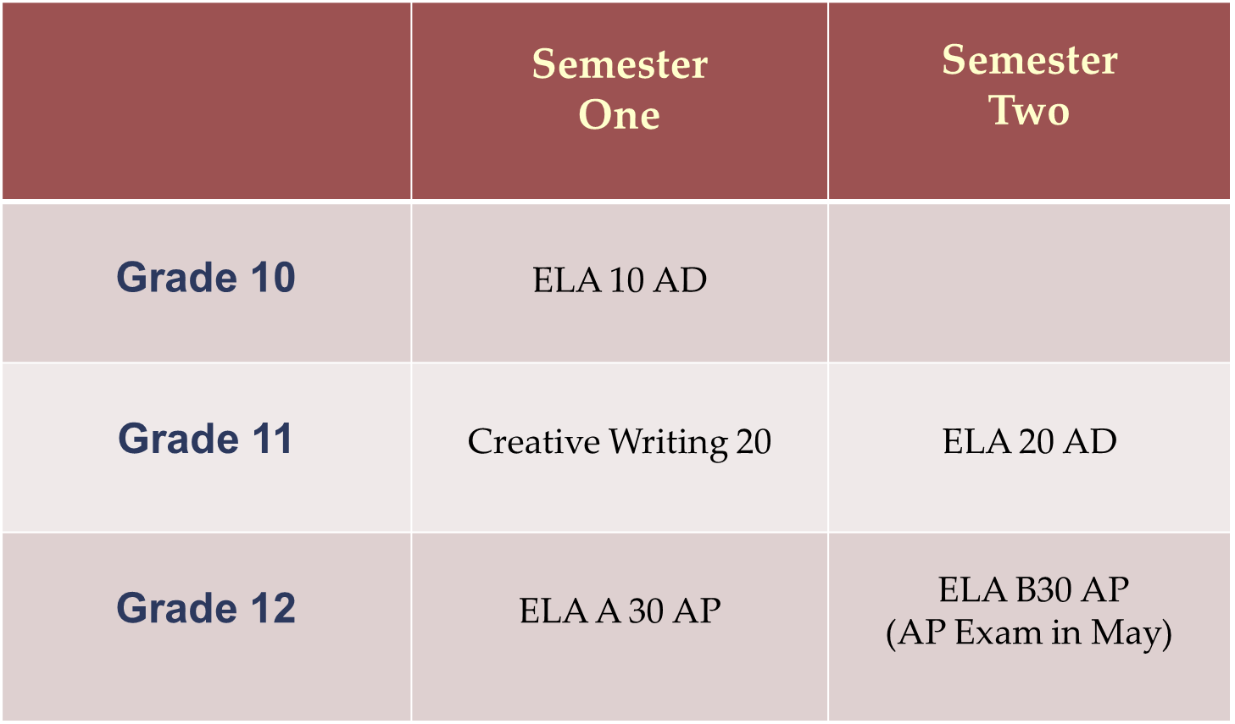
AP English Pathway

Slide 29
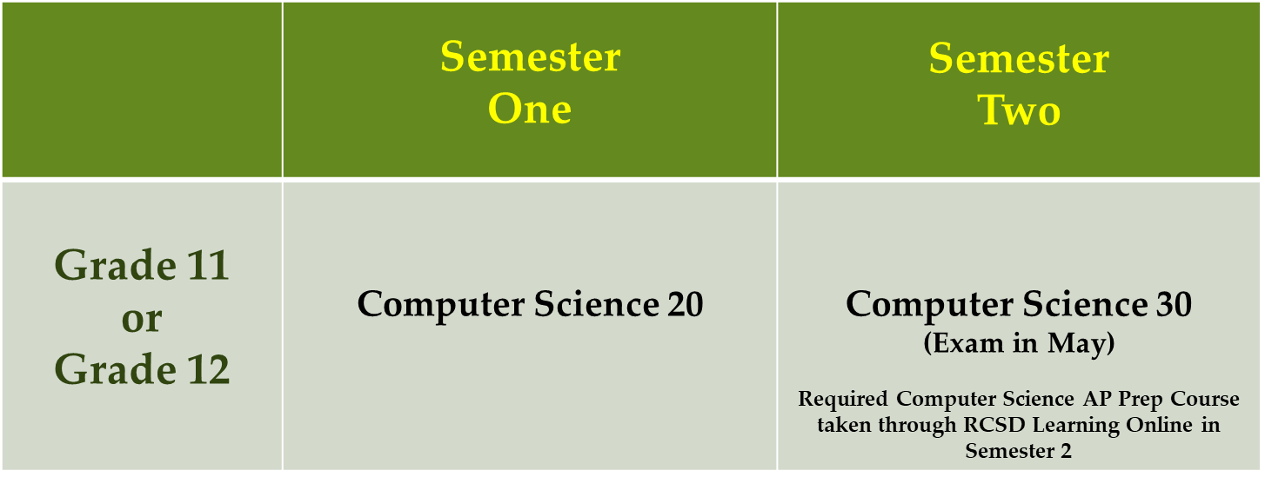
AP Computer Science Pathway

Slide 30
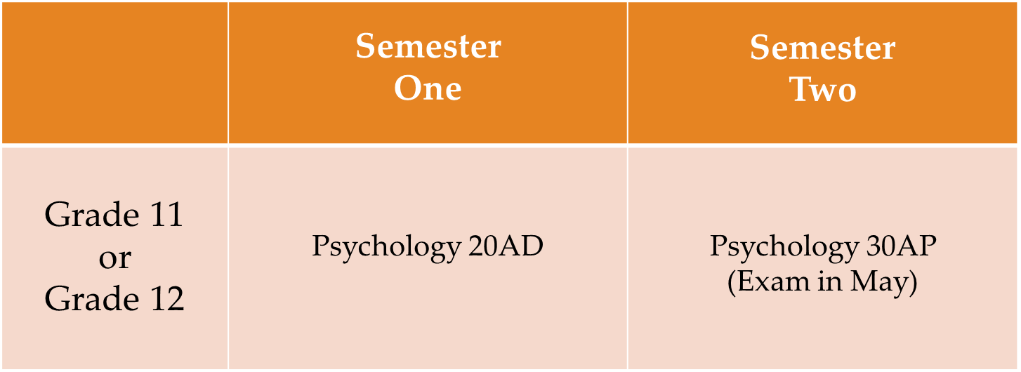
AP Psychology Pathway

Slide 31
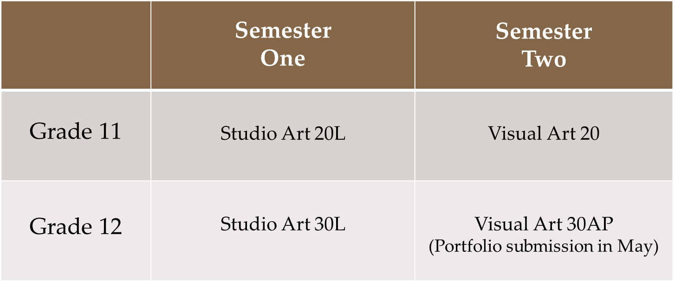
AP Art Pathways

Slide 32
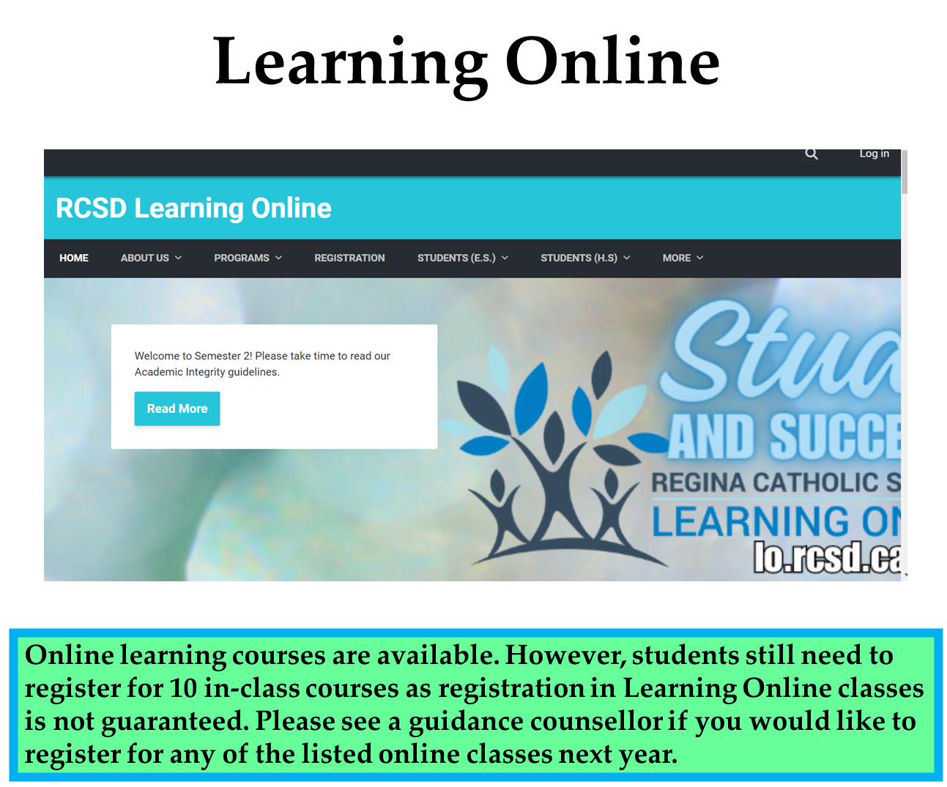

Slide 33
Do Your Homework!
Take some time in the next couple of weeks to do some planning
Reference the subject selection hand out you were given
Make sure you keep your post-graduation plans in mind when selecting your courses.
Take a look at the course description booklet. It provides a detailed description for each class we offer.
Talk to your teachers
Stop by student services if you have questions

Slide 34
Class Changes
We are projected to be over 950 students next year. This means that classes will be full. Choose classes carefully! We create classes based on what is chosen during subject selection.
Reasons for class changes…
pre-requisite issue
to meet grad requirement/post-secondary requirement
(Keep in mind that these changes can only be made if there is room in a class. It’s your responsibility to keep track of your credits and know the pre-requisites for the classes you select.)
Class changes will not be made…
X to switch spares
X because you changed your mind
X to switch teachers
X because you want to be with your friend

Slide 35
Online Course Selection
February 26th – March 5th Online Selection Process
Important that parents/guardians and students complete together.
Student must log in to their portal during this time frame and select their courses.
Please be aware that specific electives may not be timetabled if there is an insufficient number of requests - students will be notified and may need to select other options if this occurs.
Students can access and change their course selections anytime between February 28th and March 5th.
Final decisions on subject selections need to be made by 11:59 pm on Wednesday, March 5th.

